Slide 1
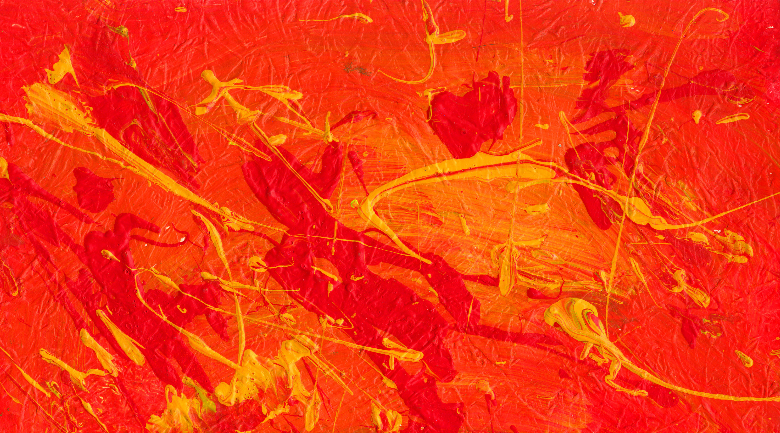
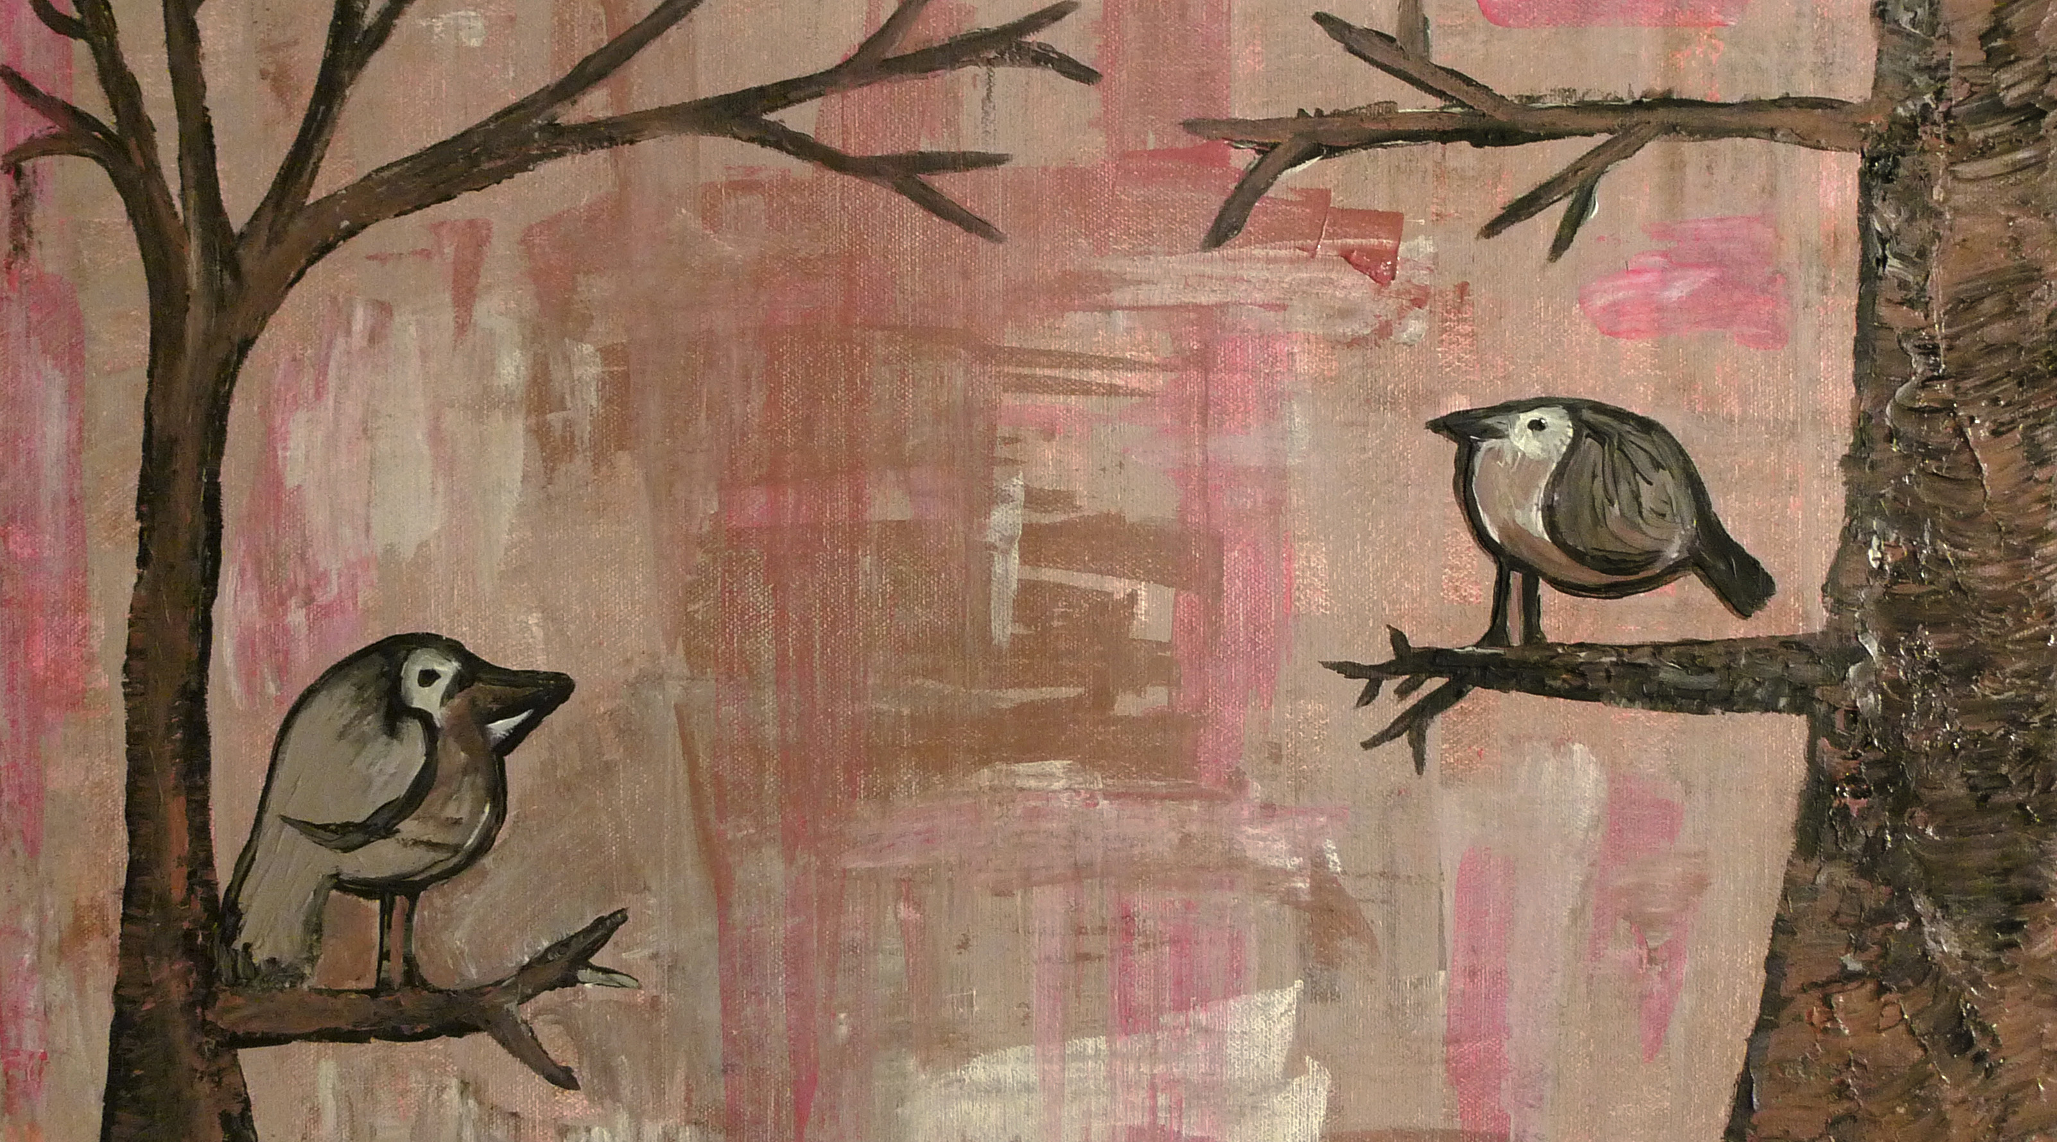
Upcoming Exhibitions
Final Weeks!
Siobhan Westhoff
February 15, 2012–March 29, 2012
Now Showing
VISION: New Works from the SAMOCA Permanent Collection
January 5, 2012–December 12, 2012
Upcoming Exhibition
Paul Shellmont: Bird Watching
April 5, 2012–June 30, 2012

Slide 2

VISION

